Slide 1
Cross-validation
Lecture 2.3
AINT351 Machine Learning
Torbjorn Dahl

Slide 2
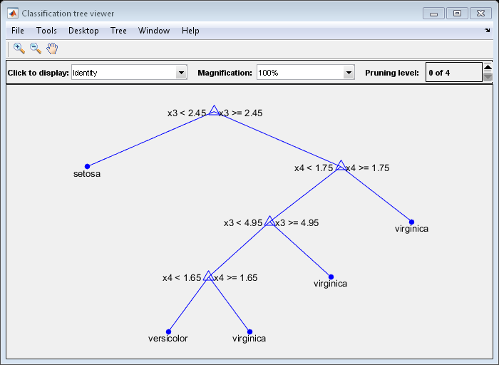
Decisions trees
A set of ordered rules for classifying data
0.3 < x3 and x3 <=0.3
Each node addresses an input variable
Leaves assign labels to the data

Slide 3
Decision Tree Learning Algorithm
T = empty tree
repeat
split data-set, D, into sub-sets, S₀-S_{n}, using T
for each subset, S_{i}
for each variables, x_{j}
for each values, v_{k}, in S_{i}
split S_{i} into sub-sets S_{i1} and S_{i2}: v_{k}>x_{j} and x_{j}>=v_{k}
find max improvement max(I(S_{i1}, S_{i2})) for split <S_{i}, x_{j}, v_{k}>
add split <S_{i}, x_{j}, v_{k}> with max(I(S_{i1}, S_{i2})) to T
until max(I(S_{i1}, S_{i2})) <= 0.0

Slide 4
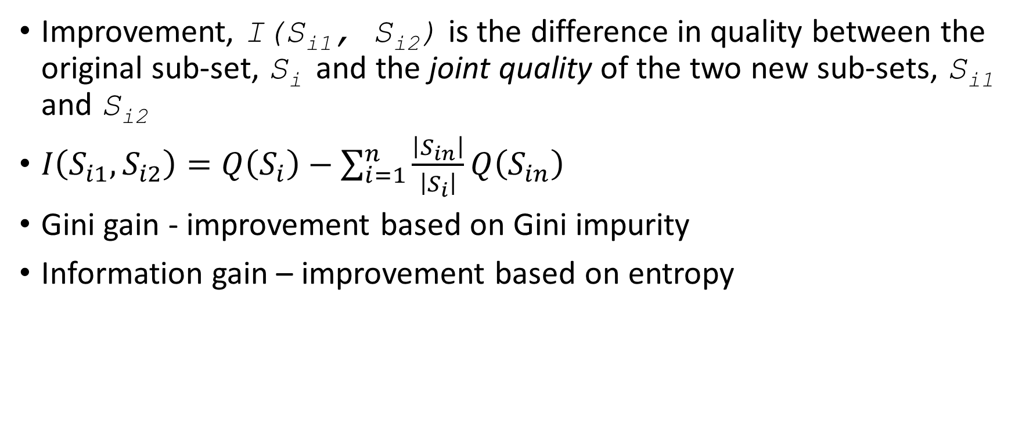
Improvement
Improvement, I(S_{i1}, S_{i2}) is the difference in quality between the original sub-set, S_{i} and the joint quality of the two new sub-sets, S_{i1} and S_{i2}
$I\left(S_{i1},S_{i2}\right)=Q\left(S_{i}\right)−\sum_{i=1}^{n}{\frac{\left|S_{in}\right|}{\left|S_{i}\right|}Q\left(S_{in}\right)}$
Gini gain - improvement based on Gini impurity
Information gain – improvement based on entropy

Slide 5
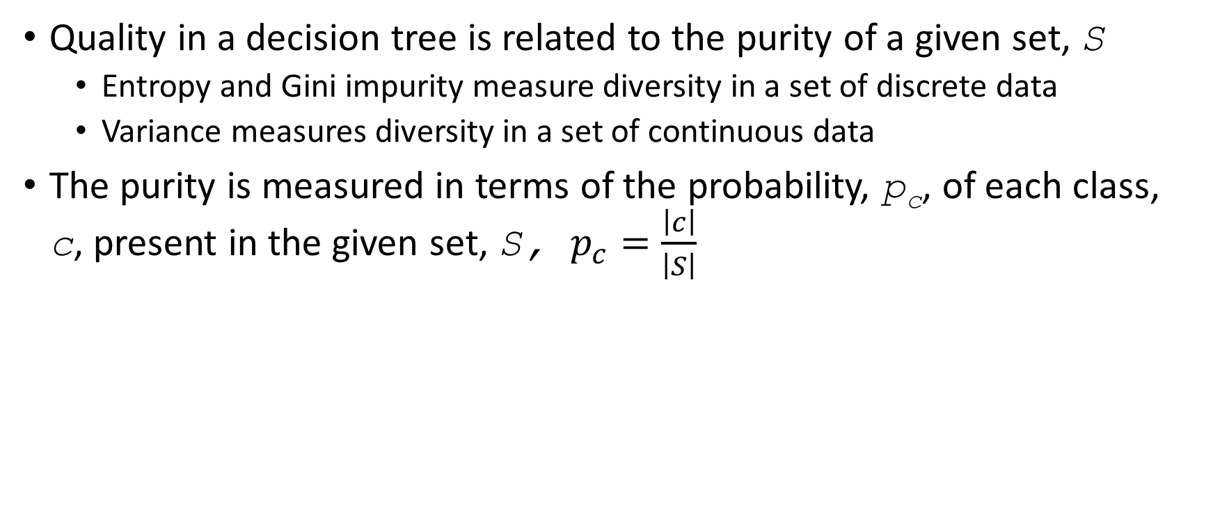
Purity Metrics
Quality in a decision tree is related to the purity of a given set, S
Entropy and Gini impurity measure diversity in a set of discrete data
Variance measures diversity in a set of continuous data
The purity is measured in terms of the probability, p_{c}, of each class, c, present in the given set, S, $p_{c}=\frac{\left|c\right|}{\left|S\right|}$

Slide 6
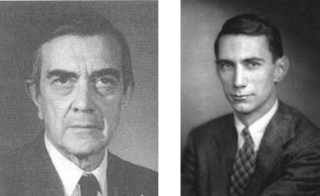
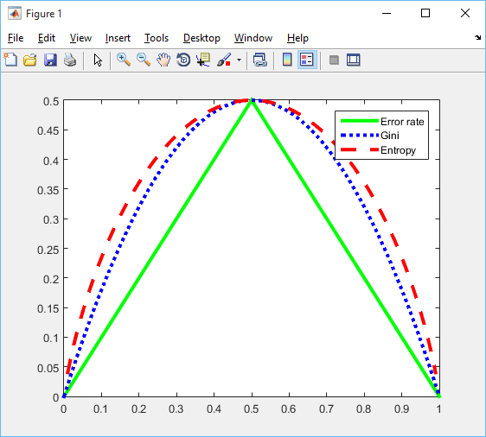

Metric Behaviour
Gini impurity
$Gini\left(S\right)=1−\sum_{c=1}^{l}{p_{c}^{2}}$
Entropy
$Entropy\left(S\right)=−p_{c}\log_{2}{p_{c}}$
Error rate
fraction of misclassified data points
plot code from pmtk3

Slide 7
Evaluating a Decision Tree
Error rate
The proportion of errors across all instances
Resubstitution error
Error rate on the training data
Tends to be optimistic due to overfitting
Test set error
The performance on a previously unseen set of test data.
Holdout
Reserving some data, often 20%, for testing

Slide 8
Repeated Testing
We need to use as much of our data as possible to maximise performance
Repeated holdout
Run several evaluations
Error estimates are averaged to yield an overall error estimate
Randomly chose test sets to use all data
Sub-optimal due to potential test set overlaps

Slide 9
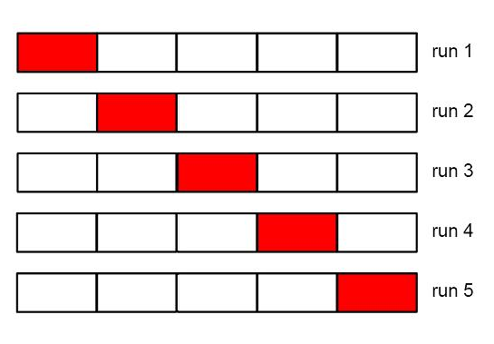
N-fold cross validation
Divide data randomly into N sets (folds) of equal size
Leave each sub-set out during training and test on that sub-set
Calculate mean performance across N folds
Plots from Machine Learning: A Probabilistic Perspective by Kevin Murphy

Slide 10
K-fold CV variants
K is commonly set to 5 or 10 based on experience
Stratification
Each sub-set has the same proportion of data from each class
Leave one out CV
Fold size 1
Best use of data and most expensive

Slide 11
The Bootstrap
Very good method for small data sets
Creates a training set by sampling with replacement
Samples a data set of N instances N times to create a new training set of N instances
Test on all instances

Slide 12
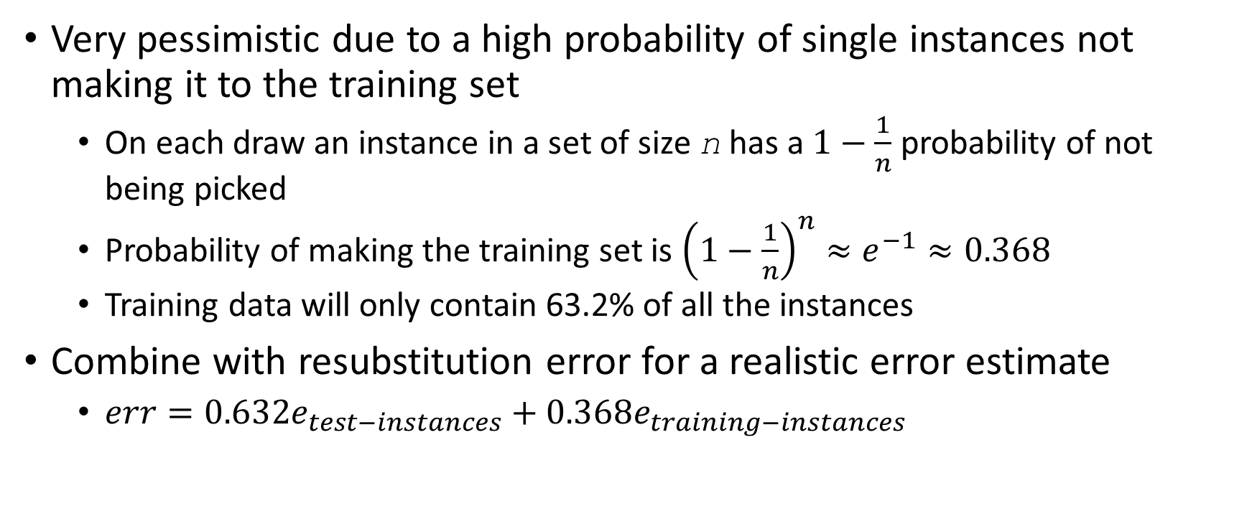
Bootstrap Properties
Very pessimistic due to a high probability of single instances not making it to the training set
On each draw an instance in a set of size n has a $1−\frac{1}{n}$ probability of not being picked
Probability of making the training set is ${\left(1−\frac{1}{n}\right)}^{n}≈e^{−1}≈0.368$
Training data will only contain 63.2% of all the instances
Combine with resubstitution error for a realistic error estimate
$err=0.632e_{test−instances}+0.368e_{training−instances}$

Slide 13
Pruning
Deciding on stopping criteria
Stopping criteria that are too specific produce small, under-fitted decision trees, e.g., in local minima
Loose stopping criteria produce large, over-fitted trees
Pruning overcomes this problem
Use loose stopping criteria or grow a full tree
Remove sub-branches that are not contributing significantly to prediction accuracy
It can also be desirable to trade accuracy for simplicity

